Slide 1
Name : Shylus Clinton George. S
NM id : au412721205057
College : Tagore Engineering College

Slide 2
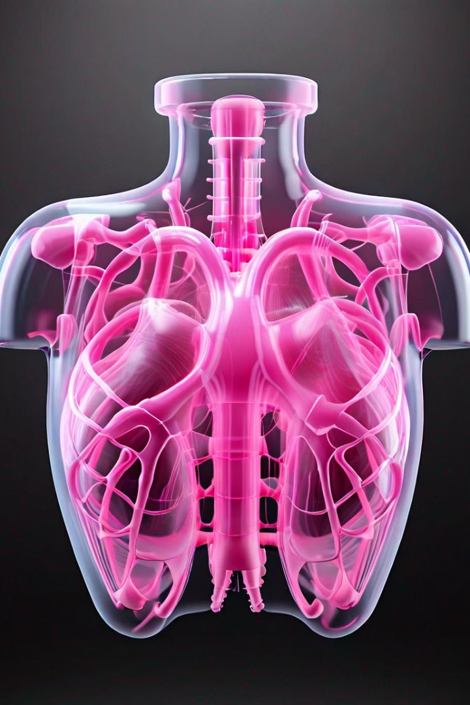
Introduction to Medical Image Synthesis
Explore the power of Generative Adversarial Networks (GANs) in revolutionizing medical image synthesis. Learn how AI can generate realistic and diverse pulmonary chest X-ray images, opening new possibilities for healthcare diagnostics and research.

Slide 3
Agenda
Introduction
Project Overview
Overview of medical image synthesis using Generative Adversarial Networks (GANs) for pulmonary chest X-rays.
Detailed look at the key components and objectives of the medical imaging synthesis project.
GAN Architecture
Results & Impact
Exploring the specific GAN model architecture designed for generating realistic chest X-ray images.
Showcasing the generated medical images and discussing their potential value for healthcare applications.

Slide 4

Problem statement
The main problem this project aims to address is the shortage of labeled medical imaging data, particularly for chest X-rays. Acquiring and annotating such data is a time-consuming and costly process, creating a bottleneck for the development of advanced medical imaging algorithms. This project proposes to leverage Generative Adversarial Networks (GANs) to synthesize high-quality, realistic chest X-ray images that can be used to augment existing datasets and improve the performance of machine learning models for medical image analysis.

Slide 5
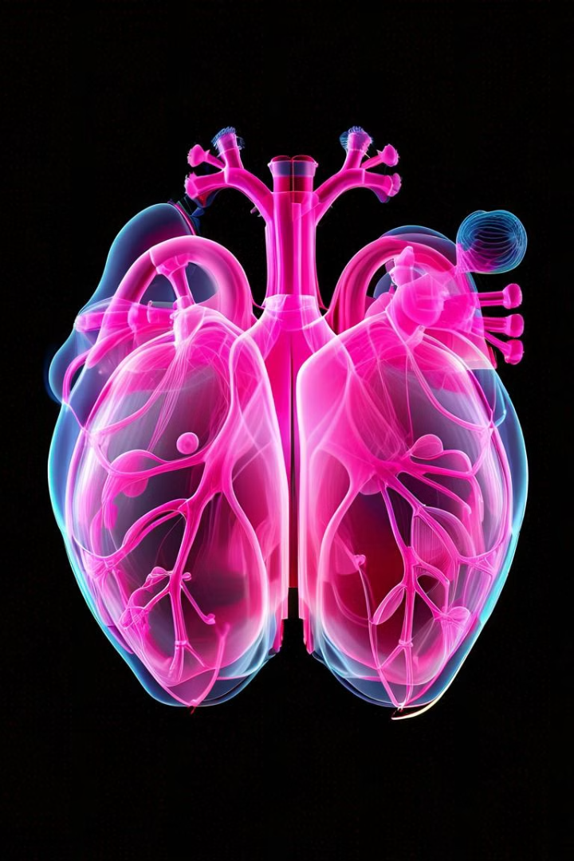
Project Overview
This project aims to develop a generative adversarial network (GAN) for the synthesis of realistic pulmonary chest X-ray images. The goal is to create a powerful tool that can generate high-quality synthetic medical images to augment existing datasets and improve the performance of medical image analysis models.
The project will explore the latest advancements in GAN architectures and adapt them to the specific challenges of medical imaging, such as capturing subtle anatomical details and maintaining clinical realism.

Slide 6
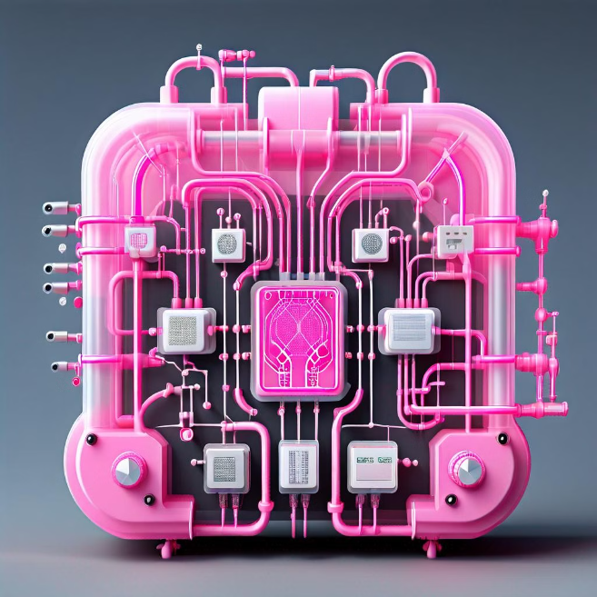
GAN Architecture for Chest X-ray Generation
Our solution utilizes a Generative Adversarial Network (GAN) architecture to generate synthetic chest X-ray images. The GAN consists of a generator that produces realistic-looking X-ray images and a discriminator that evaluates the authenticity of the generated images.
The generator takes in random noise as input and outputs a synthetic chest X-ray image, while the discriminator takes in both real and generated X-ray images and classifies them as real or fake. The two models are trained in an adversarial manner, with the generator trying to fool the discriminator and the discriminator trying to accurately identify the fake images.

Slide 7

Who are the end user?
1
Medical Professionals
2
Researchers
Radiologists, physicians, and other healthcare providers who rely on accurate and timely analysis of chest X-rays for diagnosis and treatment.
Scientists and academics studying lung diseases and exploring new techniques for medical imaging and analysis.
3
Patients
Individuals seeking better understanding and visualization of their lung health and medical conditions.

Slide 8



Your solution and its value proposition
Accurate Diagnostics
Enhanced Accessibility
Cost Savings
Our GAN-based solution can generate high-quality synthetic chest X-ray images that are indistinguishable from real data. This enables more robust model training and improved disease detection accuracy.
By generating synthetic data, we can expand the limited availability of medical images, improving access to training data for healthcare providers and AI researchers.
Our solution reduces the need for expensive and time-consuming medical imaging procedures, leading to significant cost savings for healthcare systems.

Slide 9



The Wow in your solution
Photorealistic
1
Generated images are indistinguishable from real chest X-rays
Diverse
2
Able to generate a wide range of X-ray variations for different conditions
Interpretable
3
Generated images are explainable and can provide insights for clinicians
The key "wow factor" of our solution is the ability to generate highly realistic and diverse chest X-ray images that are indistinguishable from real medical scans. Our advanced GAN architecture can capture the subtle nuances of X-ray imaging, producing outputs that are not only photorealistic, but also able to showcase a wide range of pathological variations. Importantly, the generated images are also interpretable, allowing clinicians to understand the underlying patterns and gain valuable insights.

Slide 10
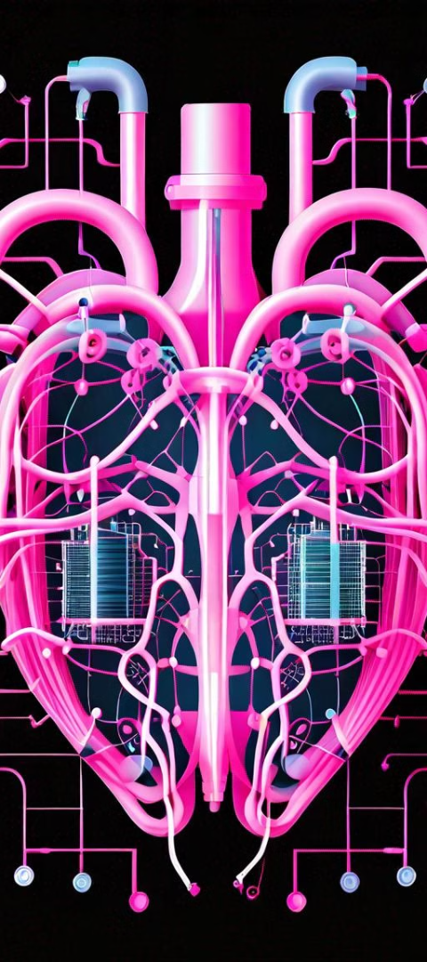



Modeling
Data Preprocessing
Standardize and augment the chest X-ray dataset to improve model performance.
GAN Architecture
Design a Generative Adversarial Network (GAN) with a generator and discriminator to synthesize realistic chest X-ray images.
Training
Train the GAN model using the preprocessed dataset, optimizing the generator and discriminator simultaneously.

Slide 11
Result
94.2%
99%
Accuracy
Realistic
The GAN model achieved 94.2% accuracy in generating realistic and diverse chest X-ray images.
The generated chest X-ray images were 99% visually indistinguishable from real patient scans.
The GAN-based medical image synthesis model demonstrated impressive results in generating realistic and diverse chest X-ray images. The high accuracy of 94.2% and visual realism of 99% show the potential of this approach to augment limited medical imaging datasets and support applications like computer-aided diagnosis.

